Slide 1
FIDELITY
INCOGNITO SQUAD,
Shashank
Anagh
Sharan
Aquib

Slide 2
Problem Statement

Slide 3
Solution
Novel solution: RFID cards !!
Cards will store database of:
Friends
Amount owed

Slide 4
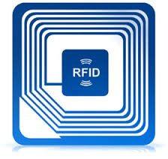
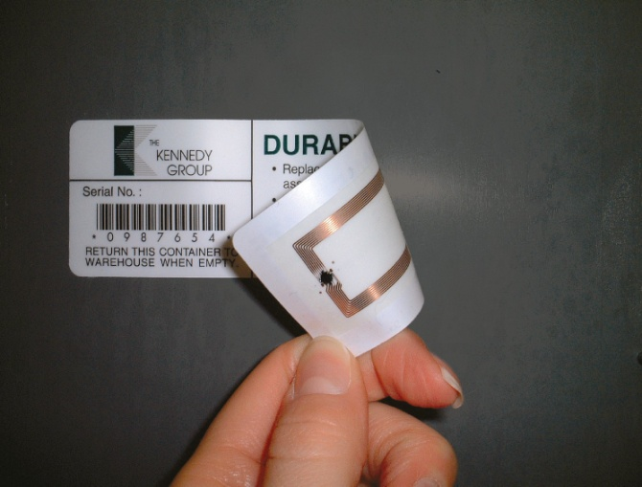
The technology: RFID
Radio-frequency identification (RFID) is the wireless use of electromagnetic fields to transfer data, for the purposes of automatically identifying and tracking tags attached to objects.
Advantages:
No line of sight required.
Tags can be read from significant distances
Multiple tags can be read at the same time.
Because tags must be enclosed, they are much more difficult to tamper.
Many tags are read / write capable, rather than read only

Slide 5
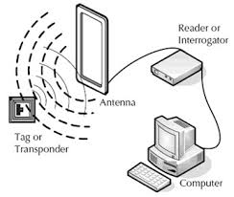
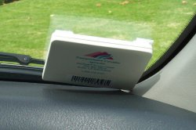
RFID Reader and Tag
RFID reader is the device capable of reading and retrieving information stored inside the RFID tags.
Two types of RFID reader:
Active RFID reader can detect an active RFID tag
Passive RFID reader can only detect passive RFID tag at a few centimetres away from the reader.
Each RFID tag has a unique serial number or ID.
Three types of RFID tags:
Active, semi-passive: RFID tags require internal battery
Passive: Do not use any internal battery.
Our prototype uses passive RFID tags or cards.

Slide 6
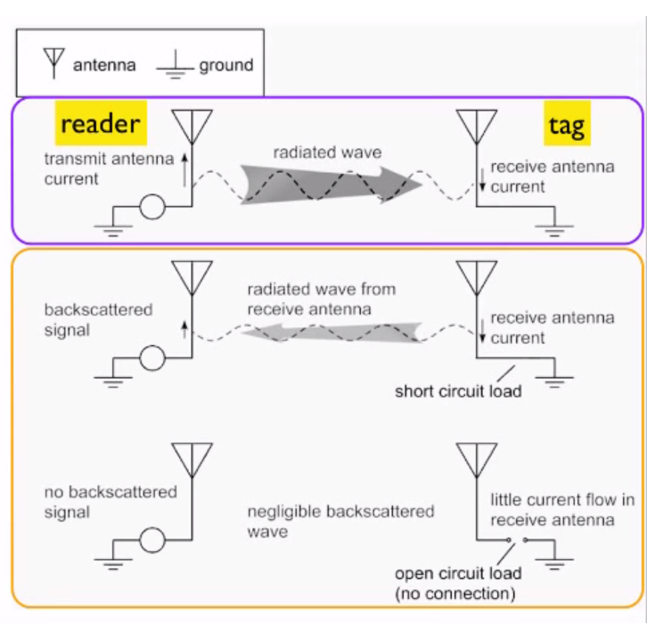
How Passive RFID Works
The reader sends a modulated carrier signal to the tag.
The tag extracts power and the transmitted message.
The induced current in the tag causes a transmission itself.
The re-transmission of can be used to send data back to the reader.
This is done by modulating the tag antenna load via a switch (transistor). This modulates the current and with that the re-transmitted wave.

Slide 7
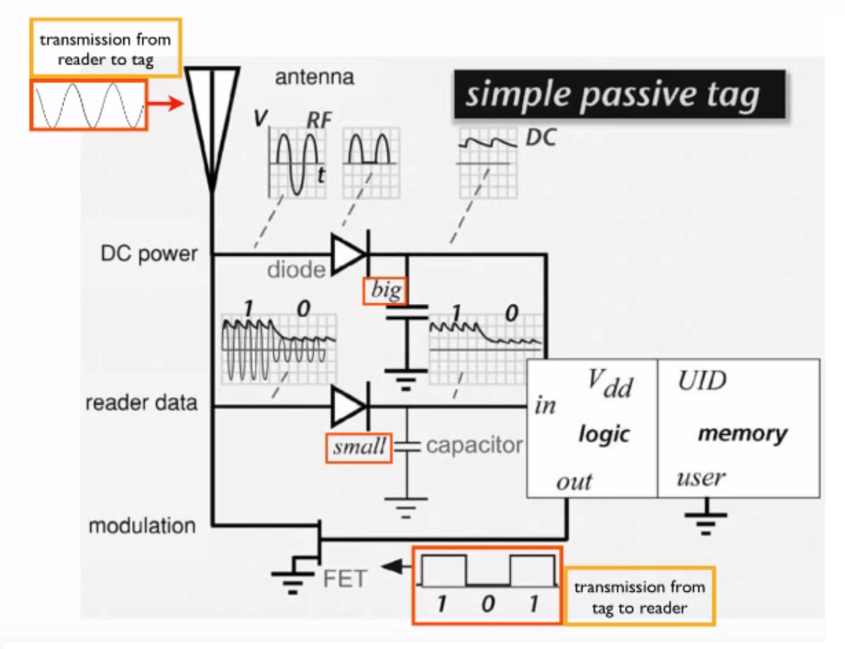
How Passive RFID Works
The reader emits a carrier wave that is amplitude modulated with the transmitted data.
The tag has two circuits :
One circuit smoothens the incoming stream into a DC supply.
The other uses a shorter time constant to achieve envelope detection - this yields a digital signal that can be interpreted by the processor.

Slide 8
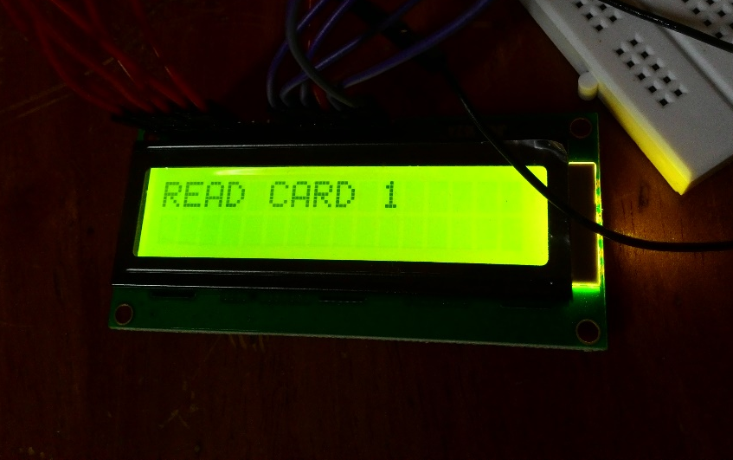
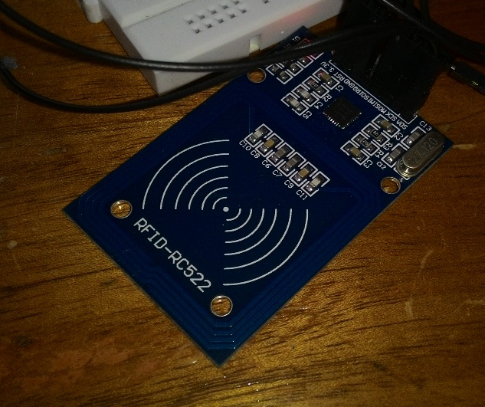
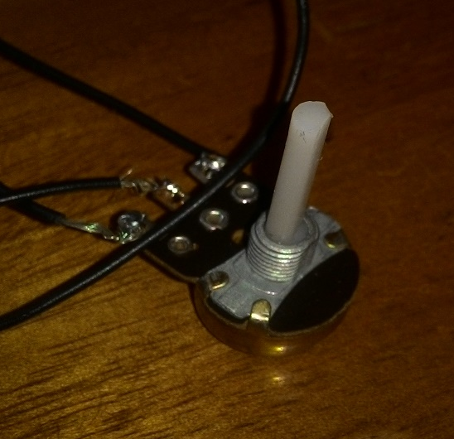
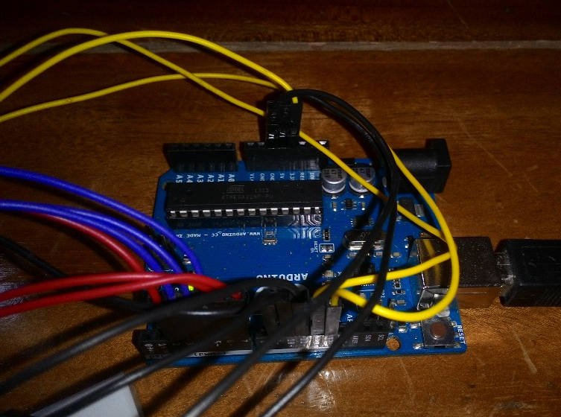
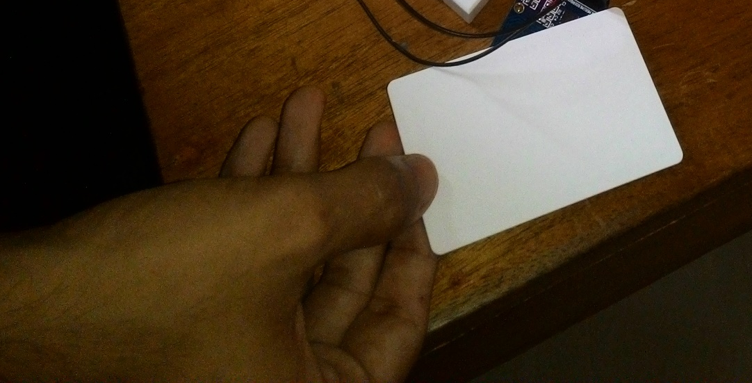
Components used for Prototype
LCD Display
Card Reader
Potentiometer
Arduino UNO
RFID Card

Slide 9
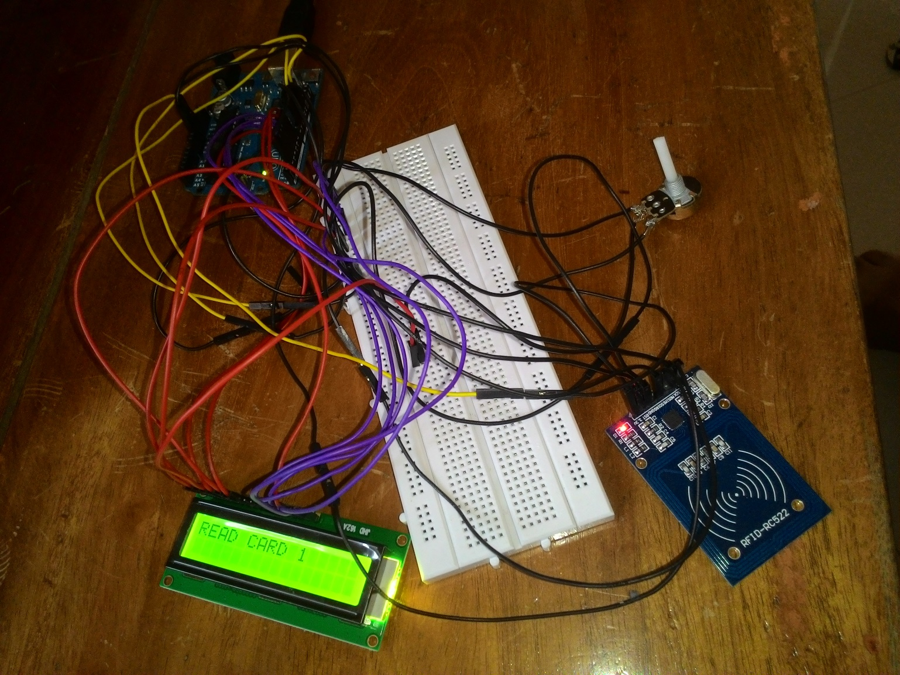
Prototype Assembly
Prototype 1

Slide 10
The User Interface
Check balance (A) or perform transaction (B) ?
If A, Swipe card. Would you like to check for specific person (1) or complete list (2)?
If 1, print specific value
If 2, print complete list, as well as total
If B, Swipe both cards (identification). Enter amount to shift. Swipe both cards again (NOTE: Order of swiping must be the Lender first and then the Borrower)

Slide 11
The program logic

Slide 12
Advantages/Benefits
Much more secure than an equivalent app
Relatively cheap hardware systems required for terminals
No requirement of cell-phone or internet connection!

Slide 13
Risks/Disadvantages
An equivalent app cheaper to implement
Have to conduct transactions ONLY at terminals
New/Existing customers have to register,change card details at product centre

Slide 14
Thank You

